Slide 1


AtliQ Hardware
Sales & Finance
Analysis
Report

Slide 2
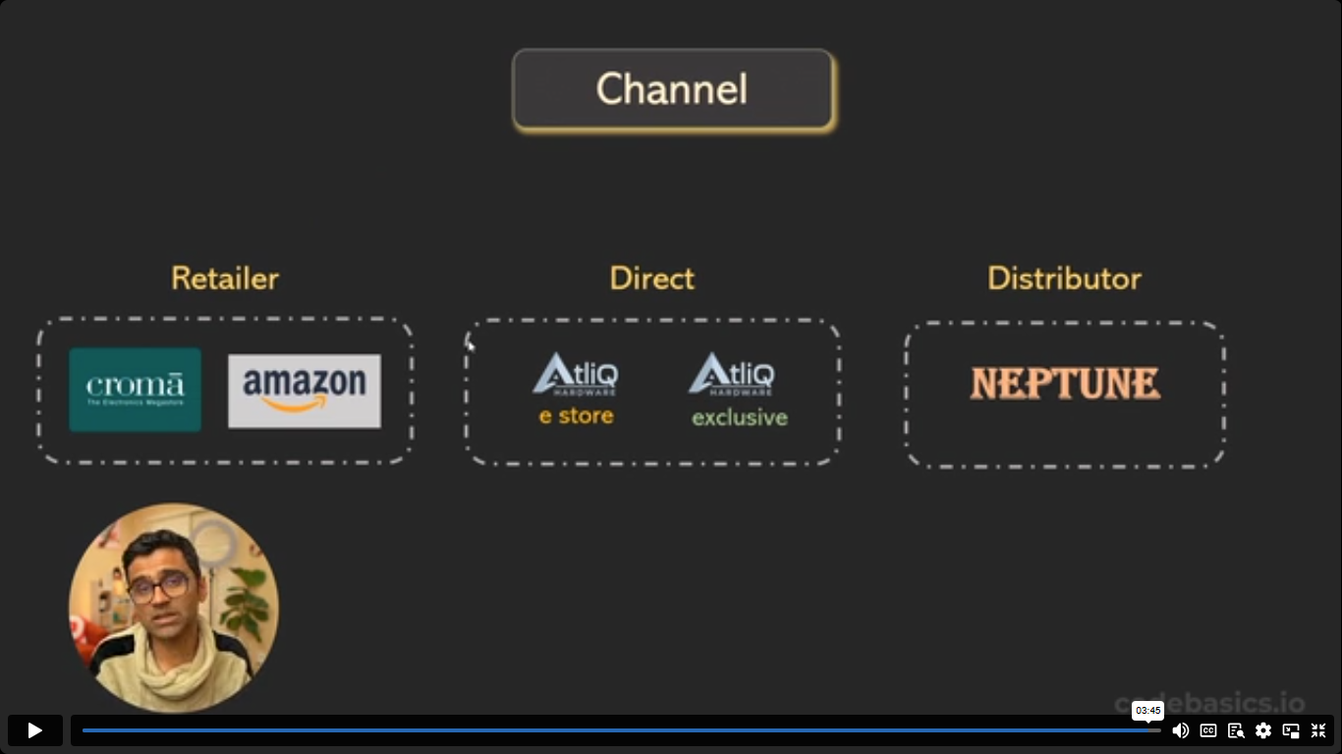
AtliQ Hardware
Introduction & Domain Knowledge
AtliQ Hardware, a hardware manufacturing company that sells products such as PCs, Keyboard, Mouse, Printers across different Countries.
AtliQ has its primary customer segments as Brick & Motor stores and E-Commerce businesses.
AtliQ operates through distinct sales channels as Retailers, Direct Sales and Distributors.

Slide 3

Primary Objective
Analyzing Market Trends across multiple region and products.
Profit & Loss by Fiscal Year to track business’s revenue and expense over a specific period.
Tracking Gross Margin Percentage by Quarters to enhance Profitability Analysis.
Identify where business have surpassed or fallen behind.

Slide 4
Methodology & Tools
Data Extraction, Transformation and Loading (ETL)
Data Modeling
Power Query & Power Pivot
DAX Measures & Calculated Columns
Pivot Table
Conditional Formatting

Slide 5
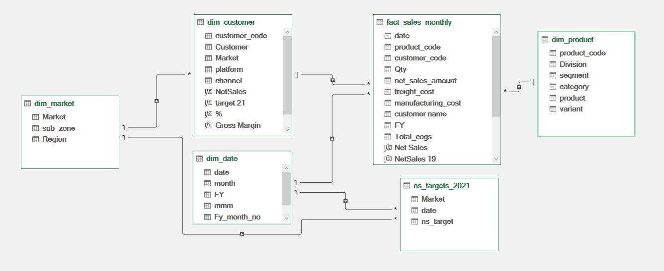
Data Modeling in Power Pivot

Slide 6
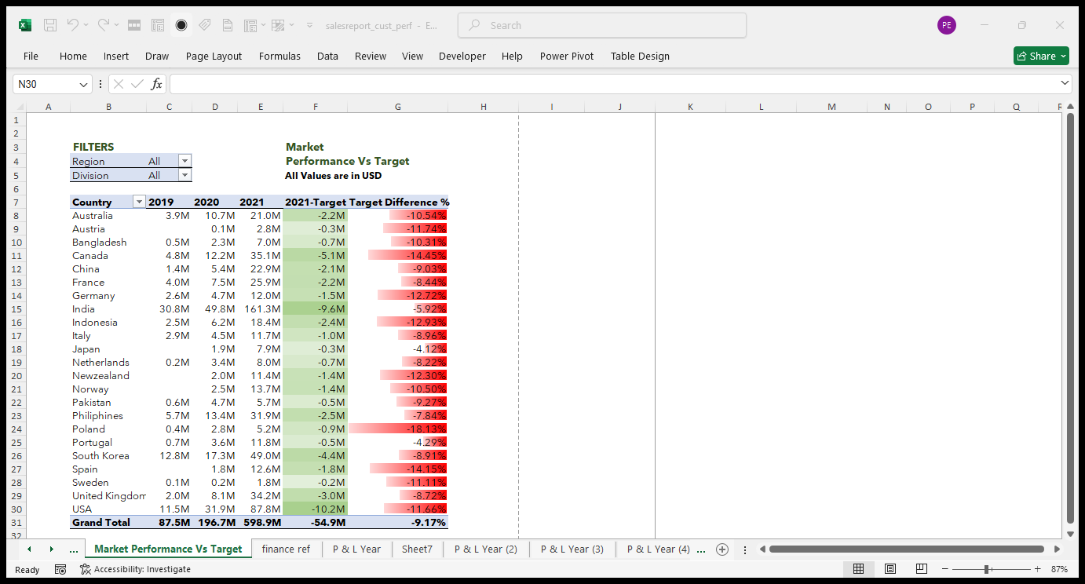
Analysis of 2021 Net Sales reveals that target is not achieved by any Country.
Conditional Formatting highlights the difference percentage of target shortfall for each country.

Slide 7
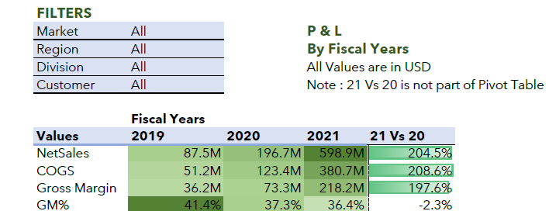
COGS(Cost of Goods Sold)
Gross Margin→(Net Sales-COGS)
GM% →(GM/Net Sales)
P & L → Profit & Loss
Profit & Loss Analysis
Profit & Loss by Fiscal Year report shows enormous growth in net sales up to 204.5% comparing 2021 and 2020, however Gross Margin Percentage has been declined.
Considering this insight of falling GM% every year, it can be improved only by decreasing the COGS value.

Slide 8
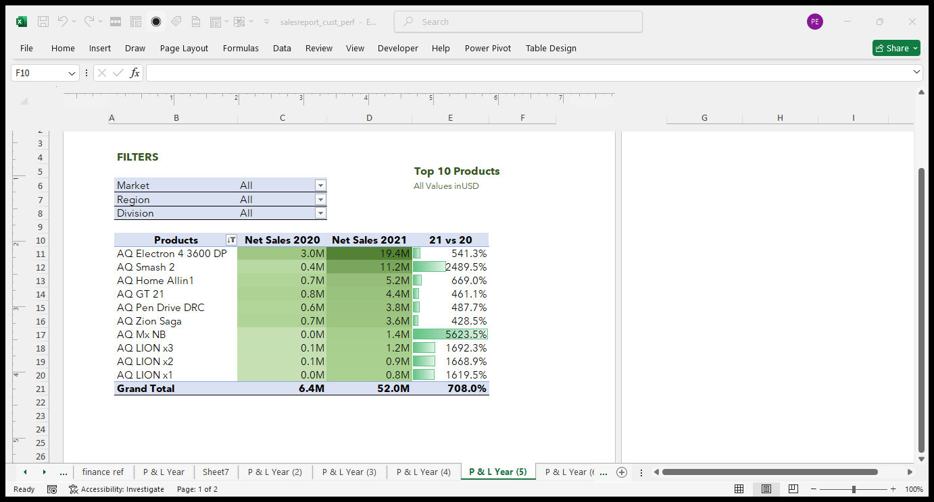
Analysis of Product Performance
This insight reveals Top 10 Products based on percentage increase in year 2021 Vs 2020
Filtered Top 10 Products based on Net Sales 2021

Slide 9
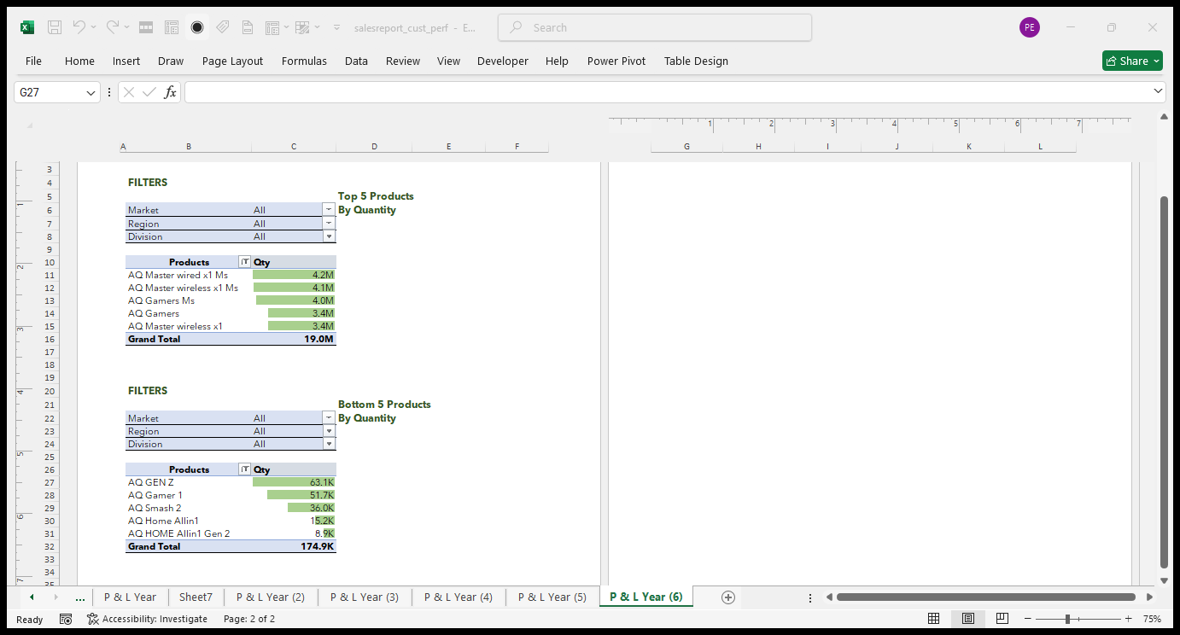
Top & Bottom Products
Based on Quantity sold, a pivot table filter was used to identify Top 5 & Bottom 5 Products.
Conditional Formatting was used to highlight Product Performance.

Slide 10
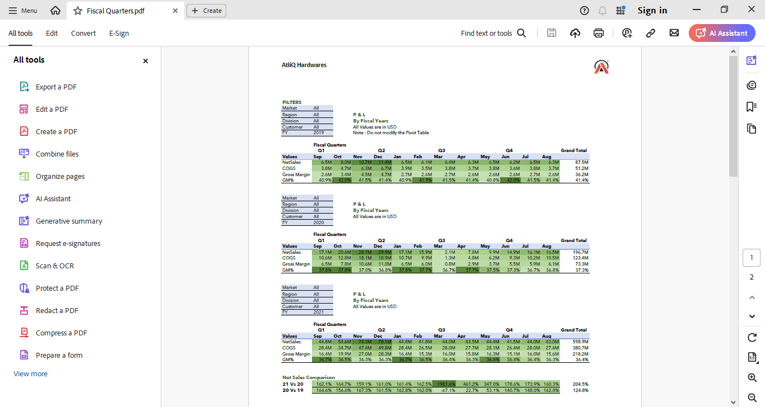

Slide 11
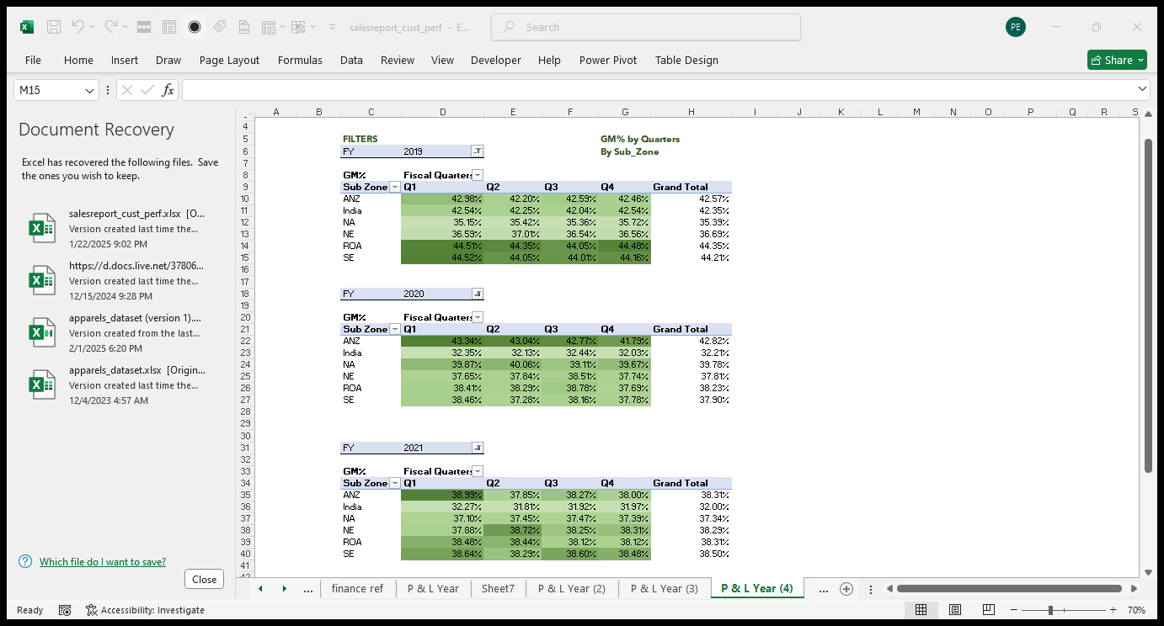

Slide 12
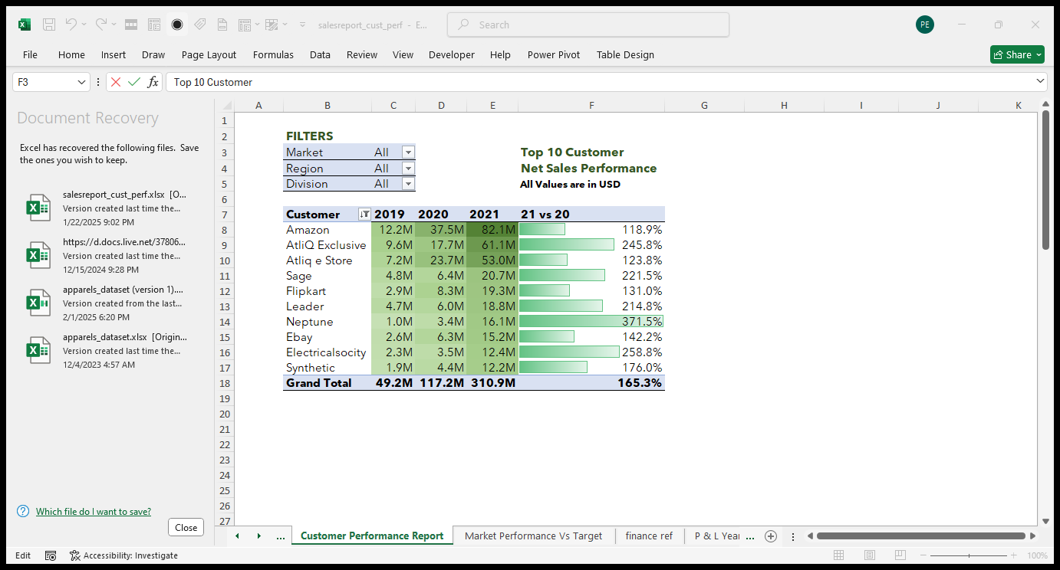

Slide 13


